Slide 1
DESN2000 MECH Workshop
Assessment Brief – Final Presentation

Slide 2
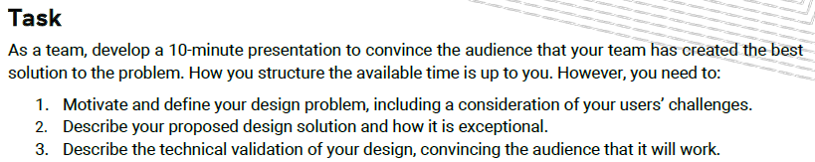
Overview
As highlighted, there is no specific structure. The core objective is to ensure your audience:
Is convinced that the problem is significant.
Believes your design is an effective solution to address the key issues of said problem.
Agrees that your idea is feasible from a technical perspective.
Relevant for all parts of the pitch, but the biggest is the technical section.
You will need to present some analytical work but pages upon pages of equations is not an effective means to communicate your device’s technical feasibility.

Slide 3
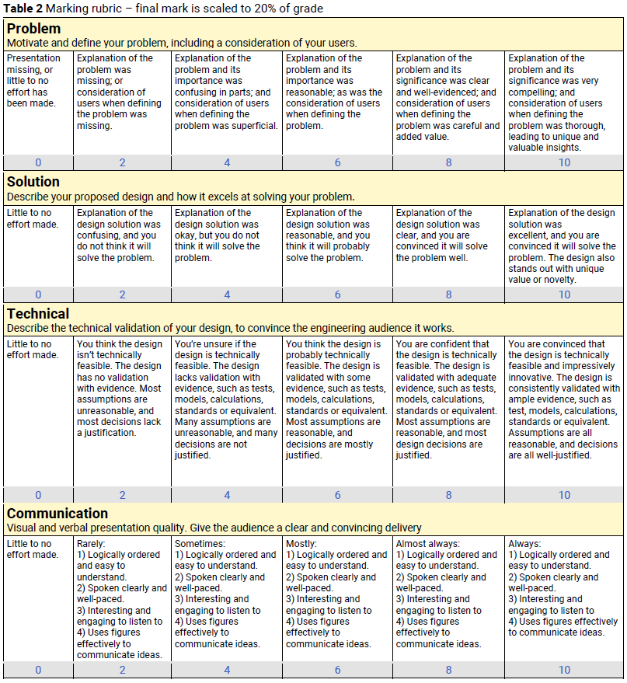
Marking Criteria
Aside from the communications tab, if you are not too sure where to start in terms of structuring your presentation, following the order of the marking criteria (problem, solution and technical) is a good sequence to start your draft with.

Slide 4
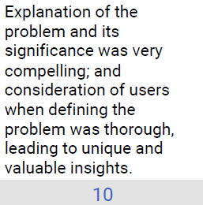
Marking Criteria - Problem
Motivate and define your problem, including a consideration of your users.
The short 1-minute pitch you developed in Week 5 can be used as a great introduction to this section!
Use it to set the scene and proceed to define your problem in greater detail.
One way to draft this section is to try presenting a highly concentrated version of the user research section of your interim presentation.
This time focus on the findings rather than the method, they can be mentioned as single phrase remarks (e.g. survey of the population found that…). The key focus is why the problem is significant, and providing insight into who is affected and how they are affected.
Generally, it is a good idea to back up any claims with statistics. These can be extracted from your user research. Infographics help a lot with this section.

Slide 5
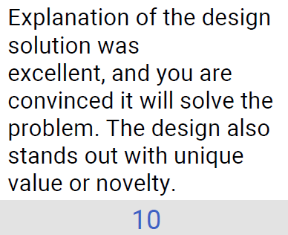
Marking Criteria - Solution
Describe your proposed design and how it excels at solving your problem.
A strong UVP statement is a great opener to summarise the unique value/novelty of your design before going into detail!
The key element to highlight in this section is how your design connects to the problem as an effective solution. Often a presentation will explain what the problem is and how the solution works, but there are not words to explain how the two are connected.
Remember, don’t assume your audience will automatically make the connection themselves.
More detailed (and labelled! Labels are great ☺) illustrations of your final concept are expected. Another piece of content worth including here is illustrating how the device is intended to be used to solve the problem, in context of where you intend to install it, showing how people/environment will interact with it.
In essence, show us how it works and why is it the best way to solve the problem.

Slide 6
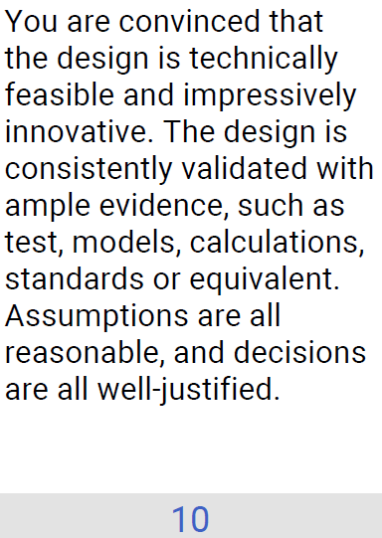
Marking Criteria – Technical
Describe the technical validation of your design, to convince the engineering audience it works.
The goal here is to demonstrate that your device is feasible from a technical perspective. There are no specified topics to include. A general guide is to try to provide a system wide analysis of your device, describing the specific components you will use and how they work together to achieve the functions you intend them to perform. Use calculations engineering theory and external sources where fitting to back up your claims.
For prototyping teams: This is where you might present your testing goals and key findings (if your device is suitable for live demonstration that would be a great addition to this section too!)
For technical analysis teams: You may opt to include some of the key findings of your technical analysis. However, you should still focus on how your device is technically valid as a whole, rather than just focusing only a particular fastener, sensor etc.
Overall, you should try to analyse your device as a whole from a technical perspective to demonstrate its feasibility.

Slide 7
Marking Criteria – Technical
Describe the technical validation of your design, to convince the engineering audience it works.
This is a section where clear communication will separate good from great. Arrange and phrase your content so that the audience is fed just enough information such that they can comprehend that your technical analysis is sound. Avoid long derivation and reading equations. Focus on:
Identify what do we need to know in order that the device is valid from a technical perspective.
Identify the key principles (analytical or theory) and explain how it can find what we need to know.
Describe the parameters/assumptions and convey the key findings of the analysis. Explain and link back to how this answers what we needed to know to prove the devices validity (first point).

Slide 8
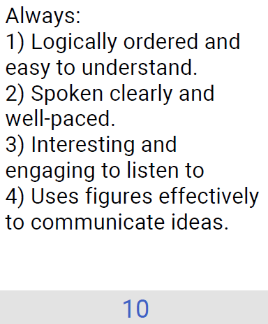
Marking Criteria – Communication
Visual and verbal presentation quality. Give the audience a clear and convincing delivery
Get this part right and the marks of everything else goes up! The easier we can understand your ideas, the more we can appreciate the depth of your work and thus the more marks we can give!
Everyone must speak! Even for a group of 8 the timing would about 1 min 20 sec per member (accounting for 5 s transition). Practice, refine and practice more so you make the most of every second!
Less is more! Saying lots of content very fast will only make it harder for the audience to process all the information you are trying to convey. Scan your script thoroughly for “filler words” and format to streamline sentences.
Balance the use of pictures and text. If you must use pure text, use other techniques such as lines, shapes and colour to highlight important information for the audience.
Repeat important information onscreen! If you feel a piece of content is something the audience must remember, include it on the slide. That way, if the audience missed the information in your speech, they could still catch up by reading it.

Slide 9
Marking Criteria – Communication
Visual and verbal presentation quality. Give the audience a clear and convincing delivery.
Most importantly, practice, practice, practice!
Rehearse right down to where everyone should stand and move as each person presents their section. If you are presenting right next to the screen, try to have the person speaking always closer to the centre so they can point to the slides.
Do your best to minimise the use of palm cards. If you can already confidently present with minimal looking at them, consider trying presenting from memory. If you read from palm cards a lot, try to practice until you can just glance at them occasionally.
Use small palm cards; avoid large A4 sheets of script/phones/tablets/laptops. Having large items in your hands can be a distraction.

Slide 10
Submission and Presentation
Format: PPT or PDF
2 Places to Submit
Direct email to demonstrators
On Moodle
Due date: 2100 Sunday Week 9
One submission on each platform, per team.
Ignore the due date on Moodle, submission on Moodle is purely to open the peer evaluation tool
Presentation date: During Week 10 workshops
We will present in one of the Makerspaces (and potentially livestreamed to the cohort!) Details will be provided at a later date.
This is why we emphasise refining and polishing your presentation, you’ll be presenting to a slightly larger audience!

Slide 11
DESN2000 MECH Workshop
Assessment Brief – Final Presentation
Notes:
Refer students to the assessment brief PDF for more information. Note that there are a few dot points in the tips section that must have been left over from when the presentation was still a video submission (covid times). Those don’t apply anymore.

